Slide 1
Senior Project Overview
CSC 190 Fall 2022 – Spring 2023

Slide 2
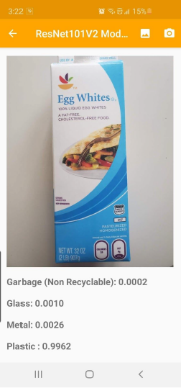
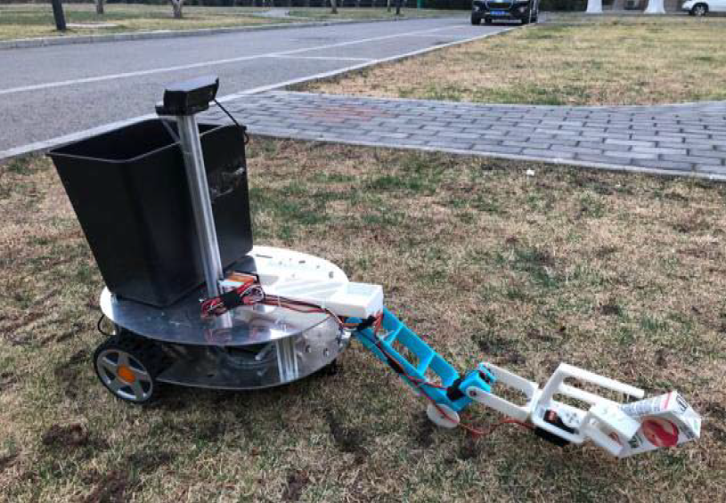
Early Trash Detection
An android app uses computer vision to classify trash into 6 material types
A theoretical trash cleanup robot designed to clean up parks and grassy areas reached 95% accuracy in detecting waste

Slide 3
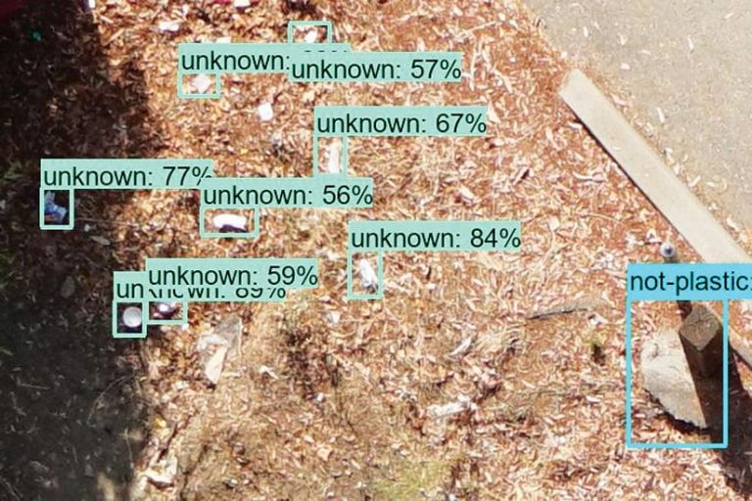
Searching for Trash using Drones
California and Bay Area coastal protection agencies are using drones and computer vision to search for trash
“To help city planners find the best ways to filter their stormwater and stop contaminants such as trash and plastics from entering their protected wetlands and public waterways” Hale

Slide 4
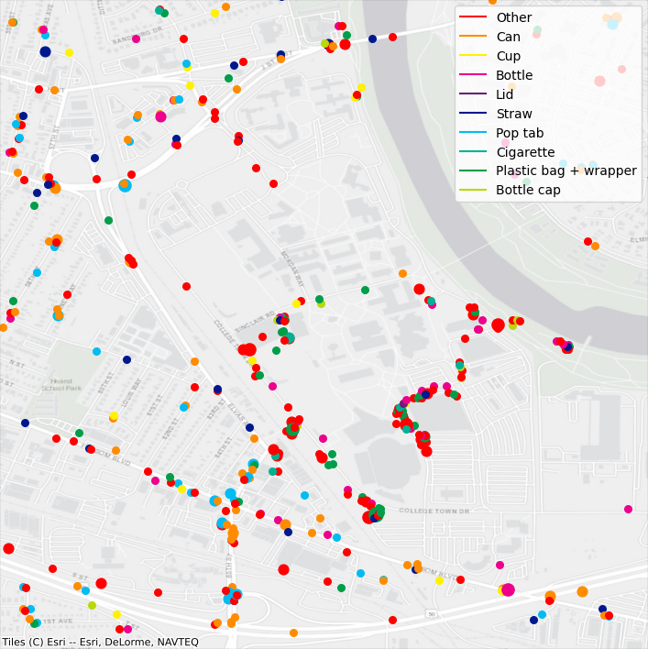
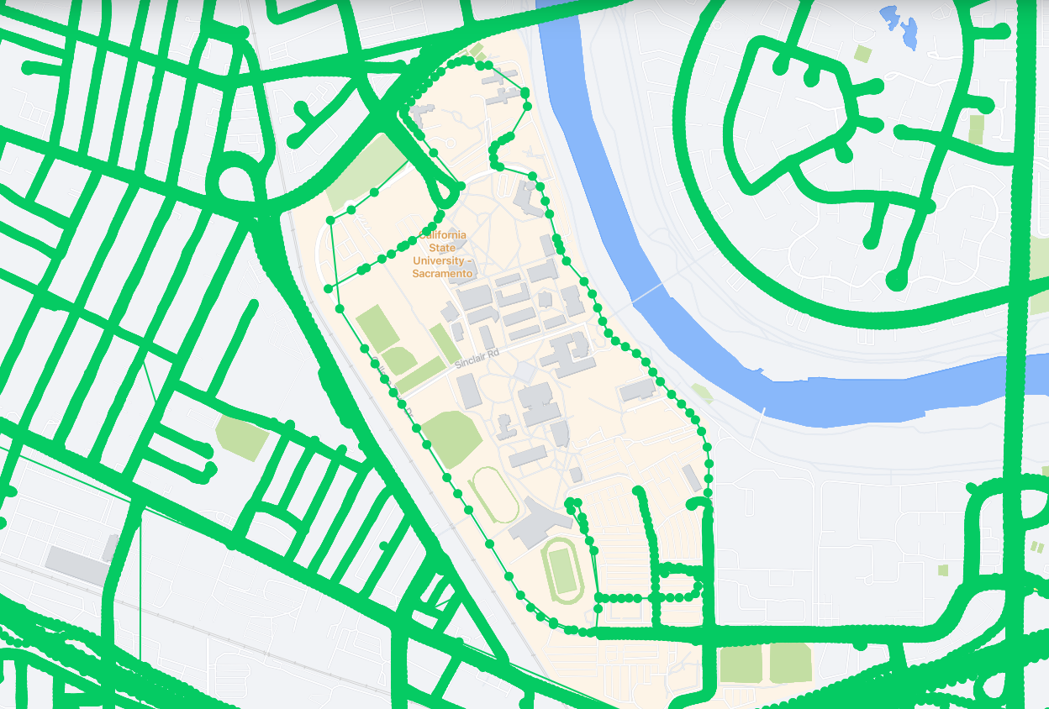
Litter Detection
Scans smartphone and Mapillary images to trash with Mask RCNN, creating a physical map of where trash is located
Mapillary image coverage
Litter detection map

Slide 5
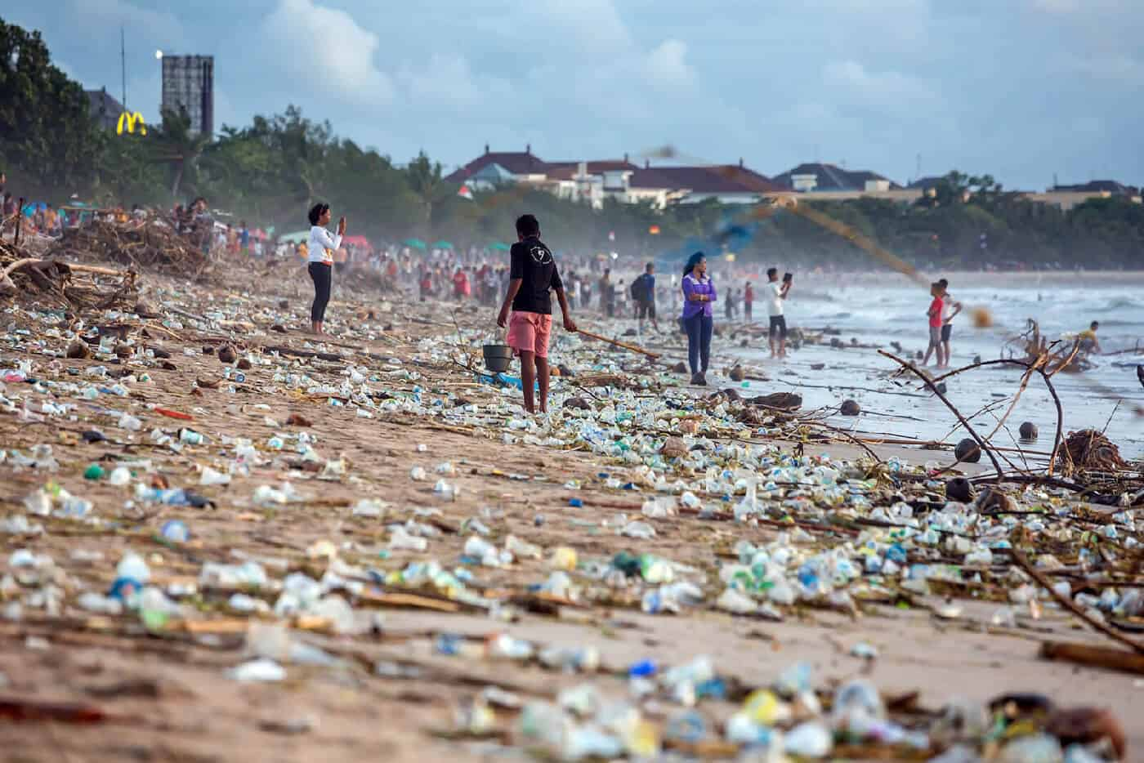
Problems
No centralized trash dataset (TACO)
1,500 images in TACO vs
35,000 in SEFI drone trash detection vs
300,000 images in the COCO dataset
Accurate detections need more generalized metadata and categories
Can it be pulled from the Sacramento waste wizard?
No real-world impact of accurate detections
Does a smart trash-can improve recycling rates?

Slide 6
Tasks
Machine learning for computer vision:
CSC 163, 177, 180
Improve the accuracy of the model to 95%+ by adding new images, and applying machine learning techniques
Web dev/database management:
CSC 134, 174, 177, 196w
Web development/database scraping for querying the waste wizard
Edge AI/hardware:
CSC 139, 159, 163
Hardware development to build a trash can module that handles inputs (camera) and outputs (LEDs or can lids)

Slide 7
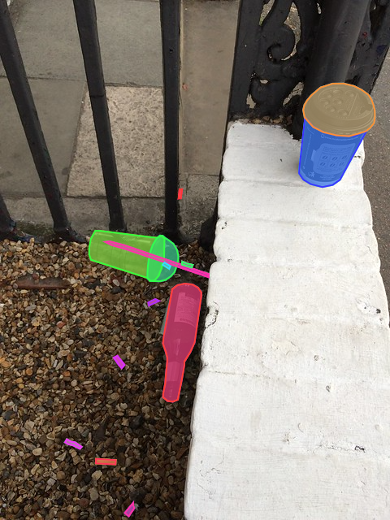
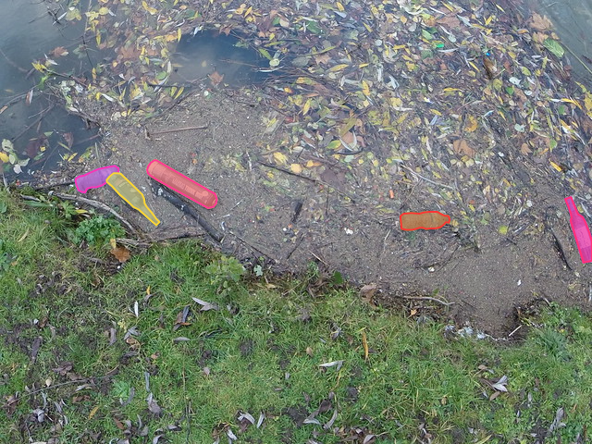
Dataset/Model Improvement
Add new images and outline the objects in them for training
Re-train Mask R-CNN with the new data and compare against the pre-trained model for precision and recall

Slide 8
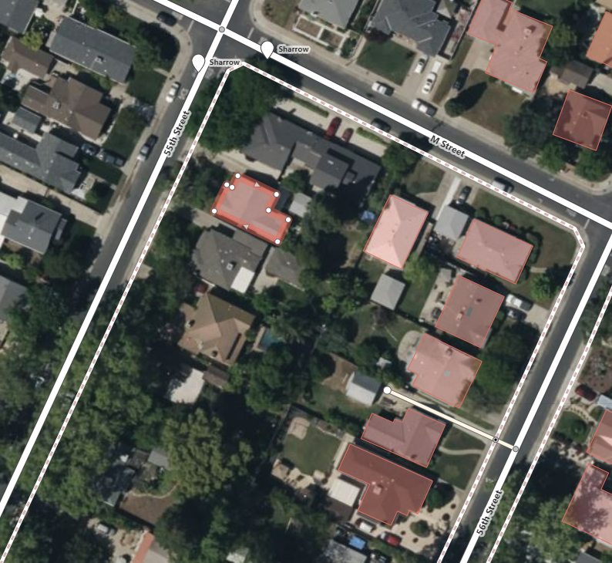
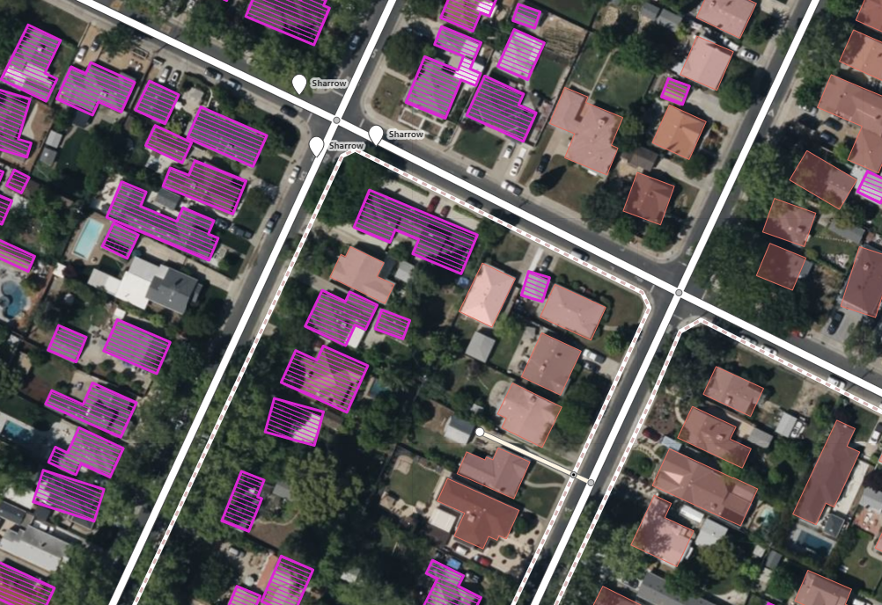
Automatic Annotations
OpenStreetMap has a similar manual annotation method
Can outline 7 buildings per minute
Facebook releases RapID, a plugin that using Mask R-CNN to suggest building outlines
Improves annotation rate to 20 buildings per minute

Slide 9
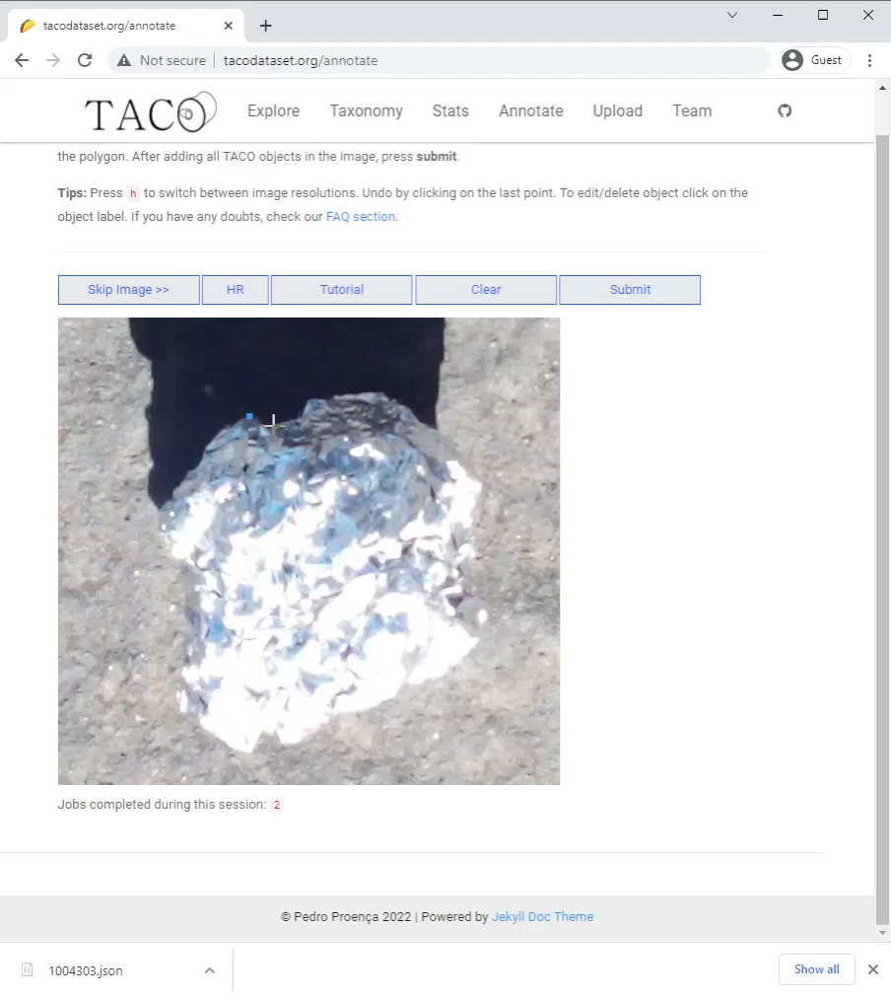
Annotations
Can we use Mask R-CNN to suggest a trash outline?
How much does this speed up annotations and how many do we need to do for this development to pay off?
How to we remove 8 photo upload limit to speed up photo uploads?
How many total annotations will we need for 95%...99% accuracy? 10,000…100,000?

Slide 10
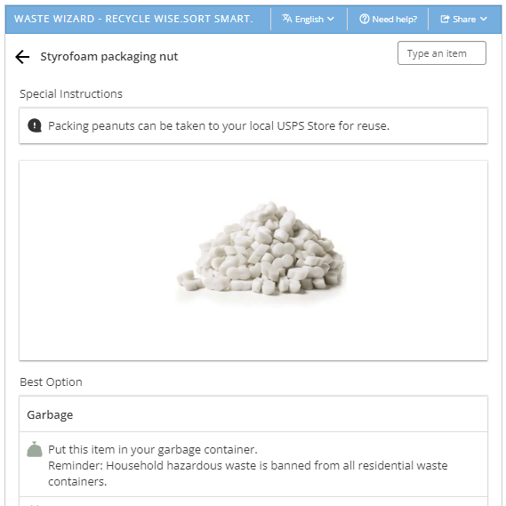
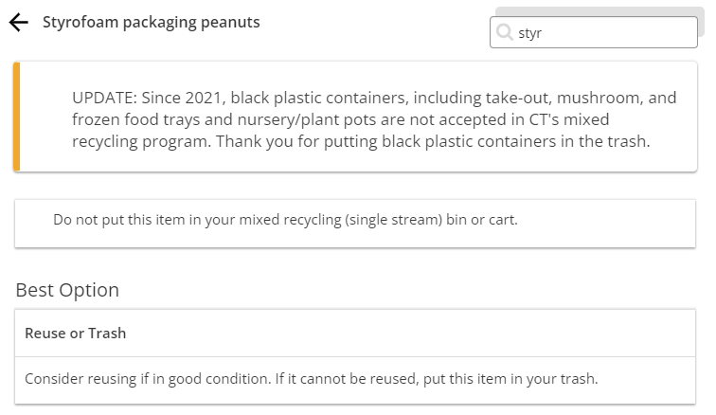
Waste Wizard
Recollect works with multiple agencies to provide location specific recycling information using the same underlying database
Connecticut Styrofoam peanuts
Sacramento Styrofoam peanut

Slide 11
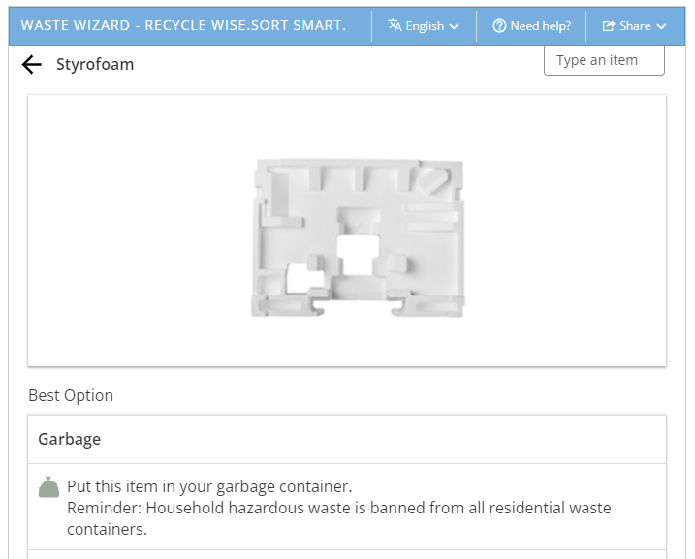
Waste Wizard
Use the predictions from Mask R-CNN to search the database: plastic bottle, Styrofoam, paper bag
The waste wizard shows which bin to put an item in using fuzzy search
We could work with Recollect and the City of Sacramento to use Mask R-CNN as a search feature
Scrape the results and return: Garbage, recycling, green waste

Slide 12
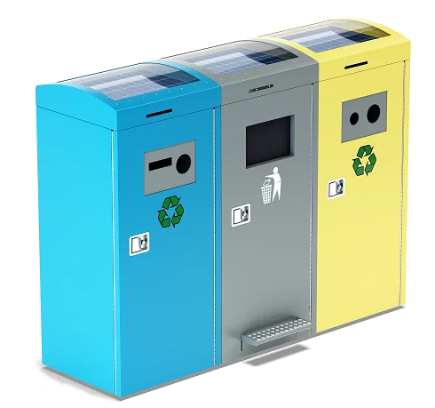
Smart Can
Use a raspberry Pi, camera, LED lights, and TPU to signal to the user which bin to place the trash into
Take a photo and scan it
Search the waste wizard and return the bin needed
Turn on the LED associated with a bin

Slide 13
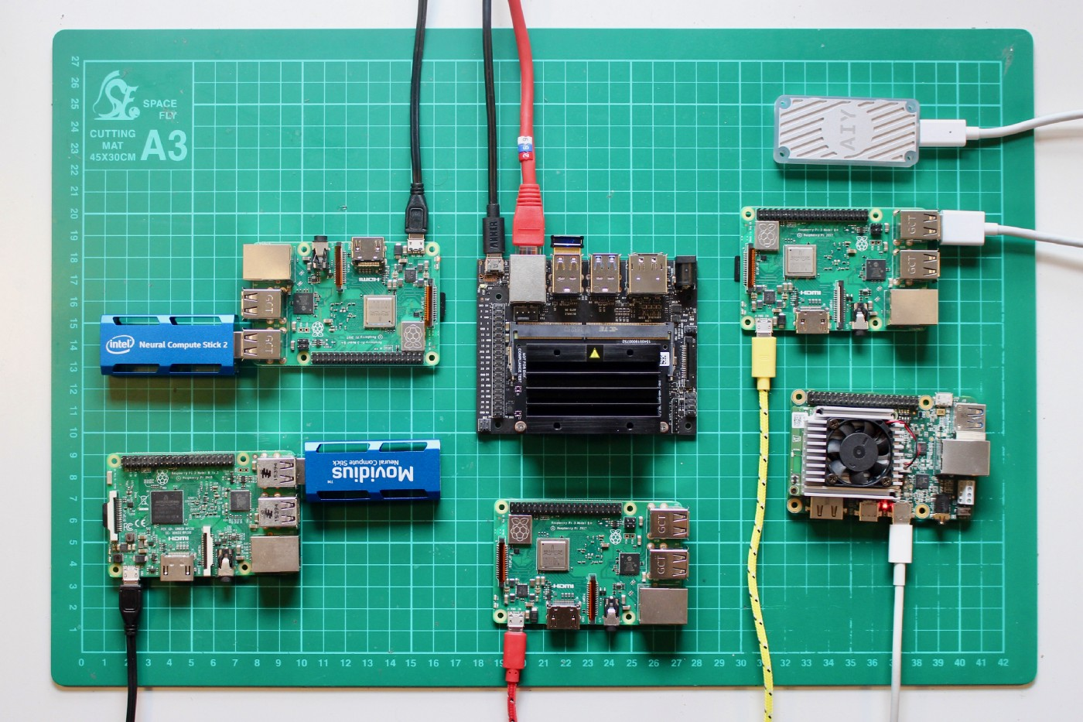
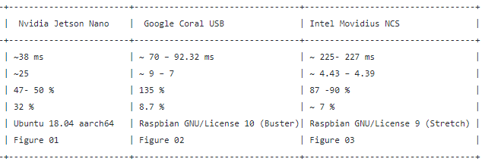
Smart Can: Edge AI
Intel vs Google vs NVIDIA benchmark
The edge AI device we choose will impact what models we can run!

Slide 14
Tasks
Machine learning for computer vision:
CSC 163, 177, 180
Improve the accuracy of the model to 95%+ by adding new images, and applying machine learning techniques
Web dev/database management:
CSC 134, 174, 177, 196w
Web development/database scraping for querying the waste wizard
Edge AI/hardware:
CSC 139, 159, 163
Hardware development to build a trash can module that handles inputs (camera) and outputs (LEDs or can lids)

Slide 15
Questions and concerns?

